Slide 1
Oil pipeline accidents
Chethan M(PES2201800331)
Anirudh R(PES2201800068)

Slide 2
Abstract
Oil is by far the most commonly spilled substance . Since 1986 pipeline
accidents have spilled an average of 76,000 barrels per year or more than
3 million gallons. This is equivalent to 200 barrels every day. Oil pipeline
accidents not only leads to the wastage of crude oil but also has adverse
effects on the environment by contaminating the water and land, leading to
water pollution and soil pollution.It also affects the economy of the country
as the repairs caused by the accident is huge. Oil leakages in the ocean
toxicate aquatic animals and plants thereby affecting the aquatic
ecosystem.Oil being a fossil fuel takes millions of years to form , should be
transported carefully with adequate measures to prevent leakage.Data
collected from various sources helps us to infer on the causes related to oil
pipeline accidents.

Slide 3
Dataset dataset link: https://www.kaggle.com/usdot/pipeline-accidents
Accidents dataset: This database includes a record for each oil pipeline leak or spill. These records include the incident date and time, operator and pipeline, cause of incident, type of hazardous liquid and quantity lost, injuries and fatalities, and associated costs. It has 2796 rows and 48 columns.

Slide 4
Variable description
S.no | Name&description | Type
1 | Report number | integer
2 | Supplemental number | Integer
3 | Accident year | Integer
4 | Accident date/time | integer
5 | Operator ID | integer
6 | Operator name | String
7 | Pipeline/facility name | String
8 | Pipeline location | String
9 | Pipeline type | String
10 | Liquid type | String
11 | Liquid subtype | String
12 | Liquid name | String

Slide 5
S.no | Name | Type
13 | Accident city | String
14 | Accident county | String
15 | Accident state | String
16 | Accident latitude | Float
17 | Accident longitude | Float
18 | Cause category | String
19 | Cause subcategory | String
20 | Unintentional release | Integer
21 | Intentional release | Integer
22 | Liquid recovery | Integer
23 | Net loss | Integer
24 | Liquid ignition | String
25 | Liquid explosion | String

Slide 6
S.no | Name&description
26 | Pipeline shutdown |  | String
27 | Shutdown date/time |  | Integer
28 | Restart date/time |  | Integer
29 | Public evacuations |  | Integer
30 | Operator employee/injuries |  | Integer
31 | Operator contractor injuries |  | String
32 | Emergency responder injuries |  | integer
33 | Other injuries |  | Integer
34 | Public injuries |  | Integer
35 | All injuries |  | Integer
36 | Operator employee fatalities |  | integer
37 | Operator contractor fatalities |  | Integer
38 | Emergency responder fatalities |  | Integer
39 | Other fatalities |  | integer

Slide 7
40 | Public fatalities | integer
41 | All fatalities | Integer
42 | Property damage costs | Integer
43 | Lost commodity costs | Integer
44 | Property damage costs | Integer
45 | Emergency response costs | Integer
46 | Environmental remediation costs | Integer
47 | Other costs | Integer
48 | All costs | Integer

Slide 8
Literature survey
An overview of leak detection and location systems. By:Lawerence Boaz,Shubi kaijiage and ramadhani shinde.
The monitoring system of Leakage accidents in crude oil pipeline and zig-zag systems.
By:Jianning ding,juanwen dang,Ninigi yuan,Qiaoling pan

Slide 9
Data cleaning
sum(is.na(data))#check for missing values data[!complete.cases(data),] #list data rows that has missing values data$Public.Evacuations[is.na(data$Public.Evacuations)]=0 data$Operator.Employee.Injuries[is.na(data$Operator.Employee.Injuries)]=0 #DELETED COLUMNS data$Operator.Contractor.Injuries=NULL data$Emergency.Responder.Injuries=NULL data$Other.Injuries=NULL data$Public.Injuries=NULL data$All.Injuries=NULL data$Operator.Employee.Fatalities=NULL data$Operator.Contractor.Fatalities=NULL data$Emergency.Responder.Fatalities=NULL data$Other.Fatalities=NULL data$Public.Fatalities=NULL data$All.Fatalities=NULL

Slide 10
Data cleaning
#setting NA values zero data$Property.Damage.Costs[is.na(data$Property.Damage.Costs)]=0 data$Lost.Commodity.Costs[is.na(data$Lost.Commodity.Costs)]=0 data$Public.Private.Property.Damage.Costs[is.na(data$Public.Private.Property.Damage.Costs)]=0 data$Emergency.Response.Costs[is.na(data$Emergency.Response.Costs)]=0 data$Environmental.Remediation.Costs[is.na(data$Environmental.Remediation.Costs)]=0 data$Other.Costs[is.na(data$Other.Costs)]=0 #Removing Rows of further NA values data=na.omit(data) write.csv(data,"new.csv")

Slide 11
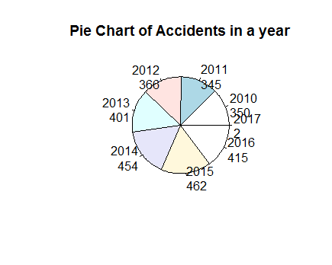
Data exploration
Accidents in a year

Slide 12
Code
mytable <- table(oilpipeline$Accident.Year)
lbls <- paste(names(mytable), "\n", mytable, sep="")
pie(mytable, labels = lbls,
main="Pie Chart of Accidents in a year")

Slide 13
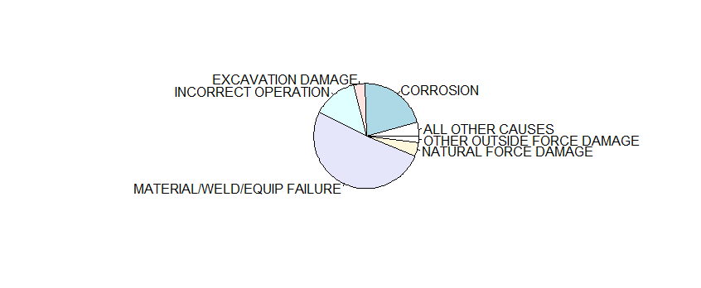
Cause category

Slide 14
code
pie(table(oilpipeline$Cause.Category))

Slide 15
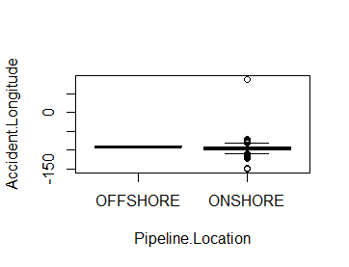
Based on longitude

Slide 16
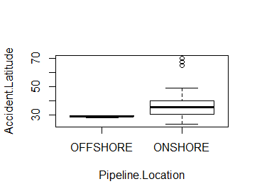
Based on latitude

Slide 17
Code
boxplot(Accident.Latitude ~ Pipeline.Location, data=oilpipeline)
boxplot(Accident.Longitude ~ Pipeline.Location, data=oilpipeline)

Slide 18
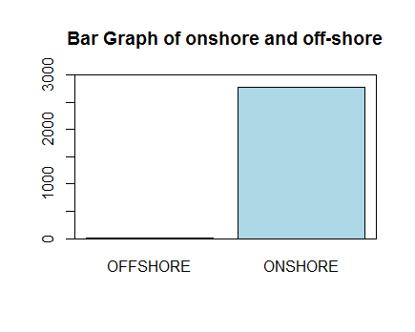
Onshore and offshore

Slide 19
Code
barplot(table(oilpipeline$Pipeline.Location),
ylim=c(0,3000),
main = "Bar Graph of onshore and off-shore",
col = "lightblue")
box(which = "plot",
lty = "solid",
col="black")
#shows that accidents didnt occur on offshore

Slide 20
Thank you

